Slide 1
Evaluation of IRI-2012 by comparison with JASON-1 TEC and incoherent scatter radar observations during the 2008-2009 solar minimum period
Eun-Young Ji, Geonhwa Jee, and Young-Bae Ham
Korea Polar Research Institute (KOPRI)
Notes:
Hello, my name is Eun-Young Ji from KOPRI.
Today, I talk about ~

Slide 2
Introduction
The International Reference Ionosphere (IRI) is the most widely used standard model for the ionospheric specification.
It is an empirical model based on the extensive database obtained from satellites and ground-based observations.
The 2008-2009 solar minimum period was unusual in terms of solar EUV level and its duration.
The level of solar EUV was extremely low and the duration of low solar activity was longer than previous minimum periods.
It should be difficult to expect for the data-driven model like the IRI to reasonably well reproduce the ionospheric parameters during this period.
Notes:
The IRI is the most widely used ionospheric model and is empirical model based on the extensive database.
The twenty eight and twenty nine solar minimum period was unusual compared with the previous minimum periods.
Therefore, it should be difficult to expect for model like the IRI well reproduce the ionospheric parameters during this period.

Slide 3
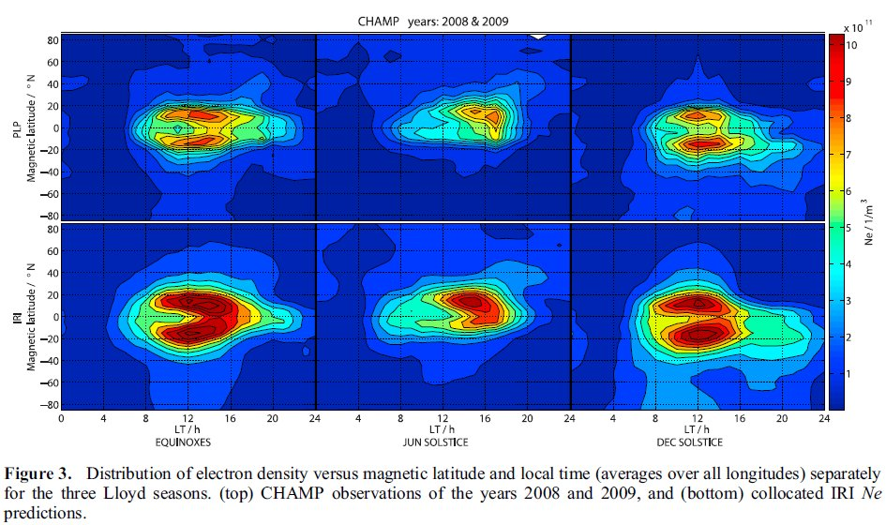
Lühr and Xiong [2010] compared the electron density of IRI-2007 with in-situ measurements of the satellite CHAMP and GRACE. They found that the IRI averagely overestimated the electron density at 400-500 km altitude by as high as 50 % and 60 % for 2008 and 2009, respectively.
Bilitza et al. [2012] further investigated Lühr’s study by using ionosonde and C/NOFS satellite data at low and mid-latitude. Their results showed that NmF2 generally agree with measurements from ionosode but the IRI overestimated the topside ionosphere as in Lühr’s study.
Notes:
Several studies have evaluated the IRI during last solar minimum period
and found that the IRI would have some problems reproducing the ionospheric parameters.
Luhr and Xiong compared the electron density of IRI twenty-seven with CHAMP and GRACE satellites.
They found that the IRI overestimated the electron density at four and five hundred km altitude.
Particularly, the IRI strongly overestimated the electron density at equatorial region in the topside ionosphere.
Bilitza et al. further investigated Luhr’s study by using ionosonde and C/NOFS satellite data at low and mid-latitudes.
They found that NmF2 generally agree with ionosode but the IRI overestimated the topside ionosphere as in Luhr’s study.

Slide 4
Research purpose
Most of previous studies evaluated the IRI in the equatorial region. In order to evaluate the IRI-2012 during the 2008-2009 solar minimum period on a global scale, we utilize the JASON-1 TEC data for the global ionosphere.
The results of the evaluation for the global ionosphere are further investigated by using the measurements of the electron density profiles obtained from the incoherent scatter radars at middle and high latitudes.
Notes:
Most of the previous studies evaluated the IRI in the equatorial ionosphere
and discussed the causes the discrepancy between IRI and observation at that region.
In this study, we further evaluate the IRI twenty-twelve with global TEC data from JASON-1 satellite during last solar minimum period.
And as a result of the evaluation for the global ionosphere, we further investigated by using electron density profiles obtained from the incoherent scatter radars at middle and high latitudes.

Slide 5
Data
JASON-1 satellite
The TEC from JASON-1 satellite provides a direct measurement of the ionospheric TEC almost every second in a vertical column extending from ocean surface to the satellite orbit at about 1336 km altitude.
In this study, we use 18 second averaged TEC data.
Incoherent scatter radars (ISRs)
IRI-2012
We use the standard version of the IRI-2012. The standard version adopts the URSI option for f₀F₂ and NeQuick topside model.
The IRI TEC is calculated at time of day, day of year, and location of our 18 seconds averaged JASON-1 TEC data along the satellite orbit.
The IRI electron density profile is hourly calculated at the day and location for each ISR.
 | Millstone Hill | EISCAT TromsØ UHF | EISCAT Svalbard Radar (ESR)
location | 42.6°N, 288.5°E | 69.6°N, 19.2°E | 78.2°N, 16.0°E
Time resolution | 8 second | 1 minute | 1 minute
Notes:
Next, I talk about the data for this study.
JASON-1 TEC provides a direct measurement of the ionospheric TEC almost every second in a vertical column extending from ocean surface to the satellite orbit at about one thousand three hundred thirty three altitude.
In this study, we use eighteen second averaged TEC data.
And, we use the electron density profile data observed from three incoherent scatter radars,
For middle latitude, Millstone Hill, For high latitude, EISCAT tromso UHF, EISCAT svalbard radars.
The time resolution of each ISR data is like this.
For this study, we use the standard version of the IRI.
For IRI TEC, we calculate at time of day, day of year, and location of our JASON-1 TEC data.
For IRI electron density profiles, we hourly calculate at the day and location for each ISR.

Slide 6
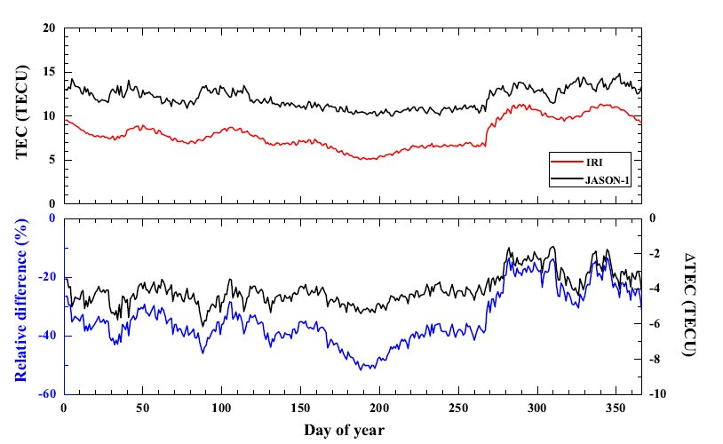
Comparison of IRI and JASON-1 TECs
Daily global mean TEC
For the global mean ionosphere, daily mean TECs calculated from the IRI and JASON data are compared with each other during the two-year period.
The IRI-2012 underestimates the TEC by about 34%.
Notes:
Next is comparison result.
First, we compare the daily mean TEC between IRI and JASON-1.
Daily mean TECs are calculated during two year period.
In this figure, red line is IRI and black line is JASON-1.
As seen this figure, IRI underestimate the TEC as JASON-1 TEC shift down.
Also, we calculate the relative difference and blue line is that.
From relative difference, we find that the IRI underestimates the TEC about thirty-four percentage.

Slide 7
Global TEC map
For the global ionosphere, we compare the global TEC maps between IRI and JASON-1TECs.
Data analysis for the global TEC map
We bin the IRI and JASON-1 TEC data in MLAT versus MLT frames.
The binning resolution for MLAT and MLT is 2° X 15min.
The binning in MLT results in longitudinally averaged TEC values.
We also use three seasonal bins:
 | Equinox | December solstice | June solstice
Day of year | 50-110 | 1-50 and 295-366 | 111-233
Notes:
We investigate the difference of global ionospheric TEC and compare the global TEC map between IRI and JASON-1.
For global TEC map, we bin the IRI and JASON-1 TEC data in magnetic latitude versus magnetic local time frame.
The binning resolution is like this.
The binning results in longitudinally averaged TEC values.
Also, we use three seasonal bins like this.

Slide 8
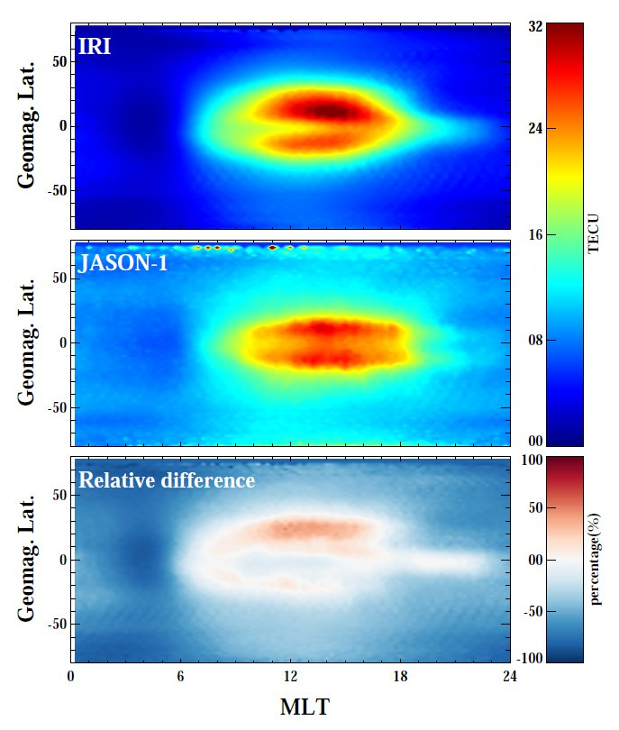
Global TEC map
Overall, the IRI underestimates TEC except for the daytime low-latitude region around the equatorial anomaly.
The equatorial anomaly in IRI does not agree with JASON TEC data:
Magnitude and location of the anomaly peaks
Symmetry around the magnetic equator
Equatorial anomaly in the evening
Notes:
This figure shows IRI and JASON-1 global TEC map and their relative difference map.
We can see that the IRI overall underestimates TEC only the IRI overestimates in equatorial region during daytime.
And we find that there is difference the location and magnitude of anomaly peak between TECs.
For this reason, the IRI shows the overestimation of TEC in daytime equatorial region.
Also, the JASON-1 TEC map shows a near-symmetric equatorial anomaly structure.
On the other hand, the IRI TEC map shows an asymmetric equatorial anomaly structure,
And the equatorial anomaly in the evening sector almost disappears in the IRI TEC map, while it stay in the JASON-1 TEC map.

Slide 9
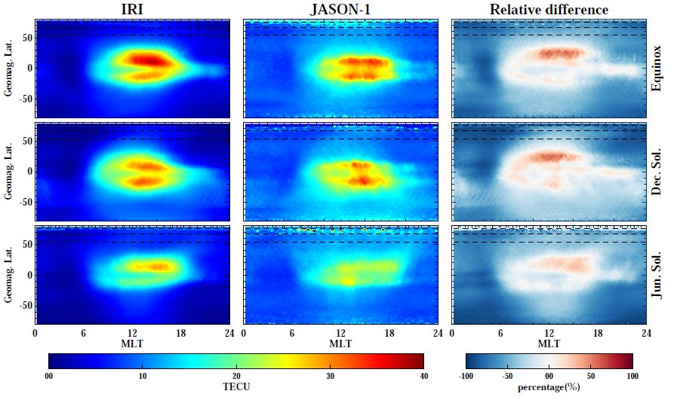
Seasonal variation of the TEC difference
Overestimation of the equatorial anomaly in the northern hemisphere
Larger underestimation of nighttime TEC in winter hemisphere
than in summer hemisphere.
Notes:
Additionally, we investigate the seasonal difference of global ionospheric TEC.
This figure shows the global TEC map at equinox, December solstice, June solstice.
We can see that the IRI overall underestimates TEC except for the region around the equatorial anomaly during the daytime in all seasons.
Also, we find that in winter hemisphere, the magnitude of underestimation of TEC by the IRI is larger than that of summer hemisphere.
This result indicates that the IRI estimation of TEC is considerably smaller than the true ionosphere in winter hemisphere.

Slide 10
Comparison of IRI and ISRs electron density profiles
Using the observations in the topside ionosphere, the previous studies showed that the IRI overestimates the ionosphere in the equatorial region during the last solar minimum period, which agrees with our result from TEC data.
However, we find that the IRI overall underestimates the ionosphere except for the daytime equatorial region.
Using the ISR observations, we further investigate the underestimation of IRI in the middle and high latitude regions.
We compare the electron density profiles between IRI and ISRs at Millstone Hill, EISCAT, and ESR.
Data analysis for electron density profiles
We make the ISR data, which have the height variation of 25 km altitude because they show the irregular height variation.
We bin the ISR data in season and local time with three seasons (equinox, December solstice, and June solstice) and 1 hour
Notes:
The previous studies showed that the IRI overestimates the ionosphere in the equatorial region during the last solar minimum period.
This agrees with our result from TEC data.
But, we find that the IRI overall underestimates the ionosphere except for the daytime equatorial region.
So, we further investigate the underestimation of IRI in the middle and high latitude regions.
For this study, we compare the electron density profiles between IRI and ISRs at Millstone Hill, EISCAT, and ESR.
In case of the ISR data, they show the irregular height variation. Therefore, we make the ISR data having the height variation of twenty-five altitude.
And, we bin the IRI and ISR electron density profile data in season and local time with three seasons and one hour.

Slide 11
Daytime
There is good agreement between IRI and ISRs for NmF2 and hmF2 except for ESR during the daytime. This result coincide with the small differences in the daytime TECs.
Millstone Hill
EISCAT (TromsØ)
ESR (Longyearbyen)
Notes:
This figure shows the IRI and ISR electron density profiles depending on three different seasons during daytime.
Red line is IRI and black line is observation.
We can see that there is good agreement between IRI and ISRs for NmF2 and hmF2 except for ESR.
This result coincide with the small differences in the daytime TECs.

Slide 12
Nighttime
At Millstone Hill, NmF2 and hmF2 of IRI are nearly similar to observation. But IRI underestimates in the bottom and topside, which results in the slight underestimation in TEC.
At EISCAT and ESR, the IRI electron density profiles are greatly deviated from the observations. In particular, the F-region peak altitude is very different from the mid-latitude ionosphere and the IRI seems not to be capable of estimating hmF2 in the high-latitude.
The IRI largely underestimates the topside ionosphere.
This result of the comparison of the density profiles well agrees with the large underestimation of IRI TEC in middle and high latitude nighttime ionosphere.
Notes:
Next is nighttime.
At Millstone Hill, NmF2 and hmF2 of IRI are nearly similar to observation.
But IRI underestimates in the bottom and topside,
This result coincide with the slight underestimation in TEC.
At EISCAT and ESR, the IRI profiles are greatly deviated from observation.
In particular, the F-region peak altitude is very different from the mid-latitude ionosphere
And the IRI seems not to be capable of estimating hmF2 in the high latitude.
Also, we can see that the IRI largely underestimates the topside ionosphere.
This result of the comparison of the density profiles well agrees with the large underestimation of IRI TEC in middle and high latitude nighttime ionosphere.

Slide 13
Conclusion
We have evaluated the IRI-2012 during the 2008-2009 solar minimum period.
The IRI underestimates the daily mean TEC by about 34%.
The IRI overall underestimates global TEC except for the region around the equatorial anomaly only during the daytime, regardless of season.
Larger underestimation of nighttime TEC in winter hemisphere than in summer hemisphere.
During the daytime, there is near good agreement between IRI and ISRs for NmF2 and hmF2 at Millstone Hill and EISCAT.
During the nighttime, the IRI largely underestimates electron density in topside. Its electron density profiles are also greatly deviated from observation in the high latitude.
Notes:
Conclusion.
In this study, we have evaluated the performance of the IRI during last solar minimum period.
The results, ~~~

